Slide 1


SENTIMENT ANALYSIS ON
AMAZON REVIEWS SYSTEM

Slide 2

GROUP - 4
Team members
1.Kiranvel R
2.Vaishnavi K S
3.Abhishek U B
4.Smrithi Radhakrishnan
5.Simhadri Mani Shankar
6.Kavimani Reddiyar
7.Akshara A.S
8.Sushinth V S
9.Saran Prakash B

Slide 3

Introduction
Sentiment analysis is the process of determining the emotional tone behind words.
This project analyzes Amazon Data Setproduct reviews to classify sentiments.
It helps understand customer satisfaction and product feedback.

Slide 4
Steps performed are:
1.Data Collection
2.EDA
3.Model Building
4.Model Deployment

Slide 5
1. Data Collection and Cleaning
Deﬁne the objective
Data collection is the process of gathering and measuring information from a variety of sources to get a complete and accurate dataset for analysis or model training.
Context (Amazon Reviews):
Source: amazon2.tsv file (tab-separated values)
Contains customer reviews, ratings, and sentiment labels
Collected from Amazon product review pages or pre-existing datasets
Key Columns (Example):
Review Text
Star Rating
Sentiment Label (e.g., positive/negative)
Lemmatizer and NLTK import in data collection

Slide 6
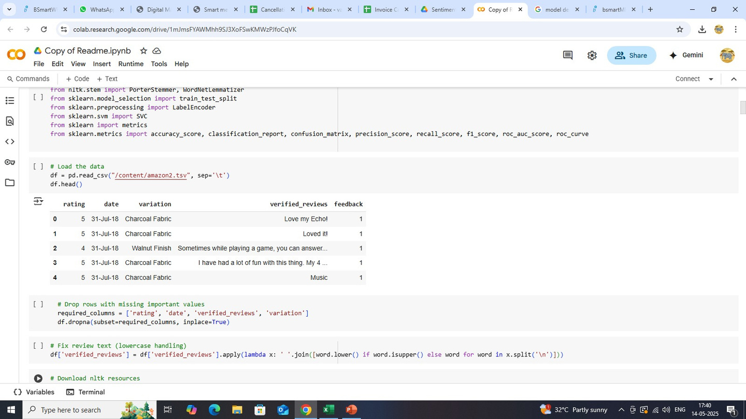
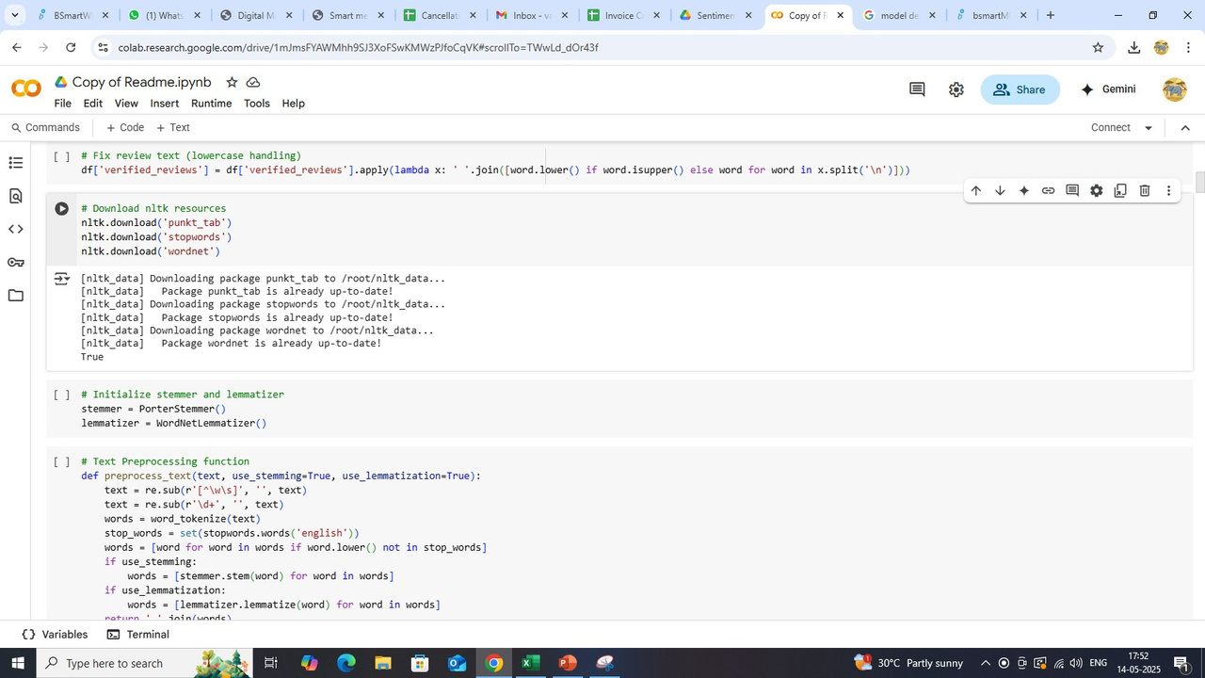
1.Data Collection
Gather data, collect the relevant data, Understand Data context

Slide 7
2. EDA
Deﬁne the objective - Understand the purpose
Data collection - Gather data, collect therelevant data, Understand Data context
Data cleaning - Handling missing values,Remove Duplicates, Correct errors
Univariate Analysis - Visualizations likeHistogram, Box plots, Bar charts
Bivariate Analysis - Explore Relationships, scatter plots, correlation matrix

Slide 8
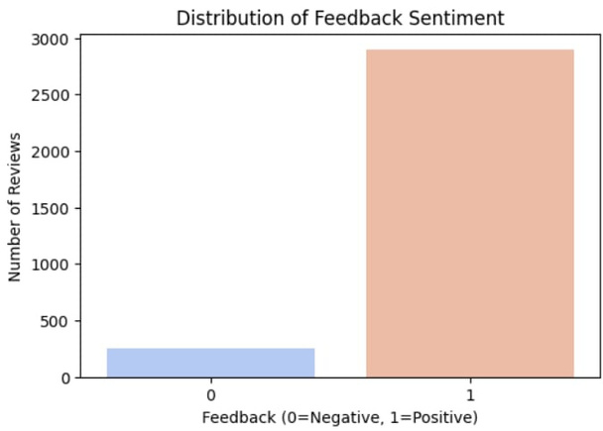
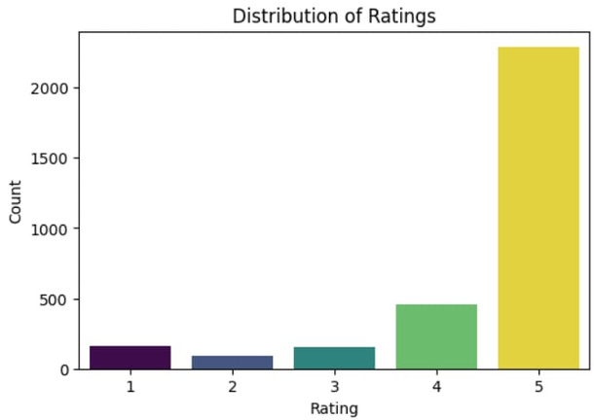
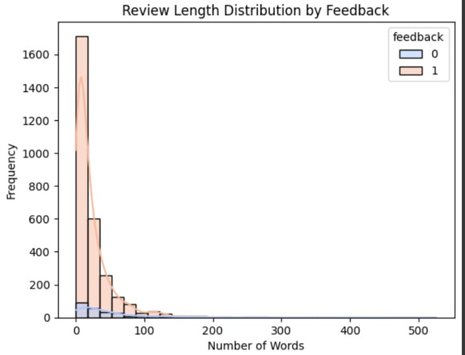
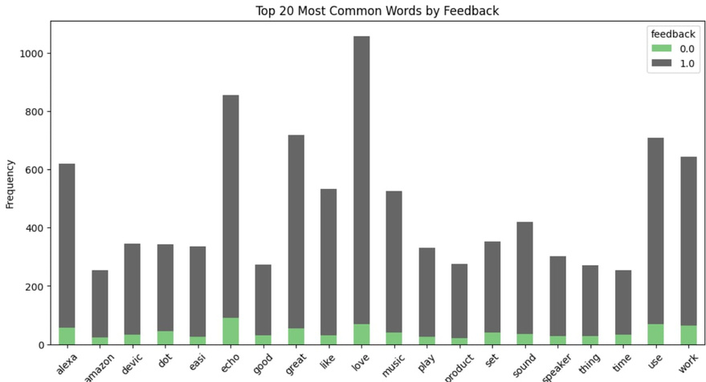
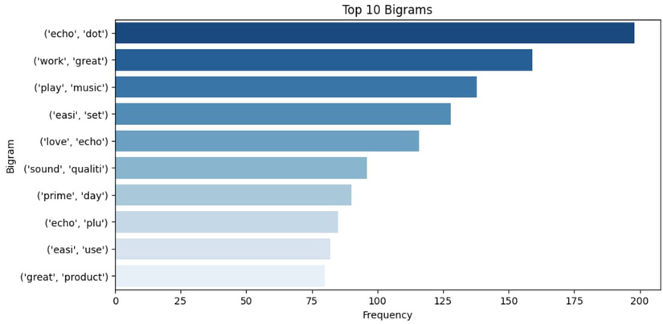
Results of EDA

Slide 9
3.Model Building
Data preparation - Feature selection,data splitting,encoding categorical variables, scalling features.
Model Selection - Choose the appropriate Machinelearning algorithm based on the problem type.
Model training - Train the model using the training dataset.
Model Evaluation - Evaluate the model’s performance using the testing dataset and appropriate metrics.
Final model - Once satisﬁed with the model'sperformance ,ﬁnalize it for deployment.
We choose a model called SVM model and Neural Network(ANN)

Slide 10
SVM MODEL
Neural Network (ANN)
Accuracy = 91.90%
Accuracy = 92.95%
Roc auc curve = 91%
Roc auc curve = 90%
Run time speed = 99%
Run time speed = 95%
Training set: 98% of the data.
Training set: 80% of the data.
Testing set: 2% of the data.
Testing set: 20% of the data.
Ensures unbiased evaluation.
Deep Learning evaluation.
Random seed set for reproducibility.
Deep seed Text for reproducibility.

Slide 11
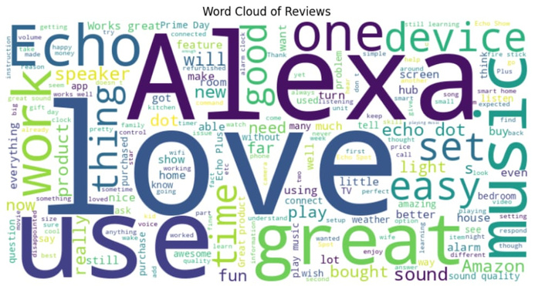
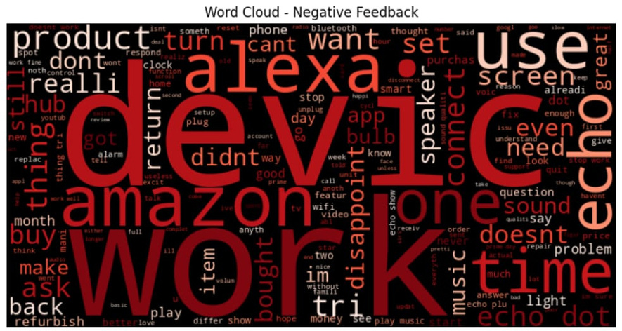
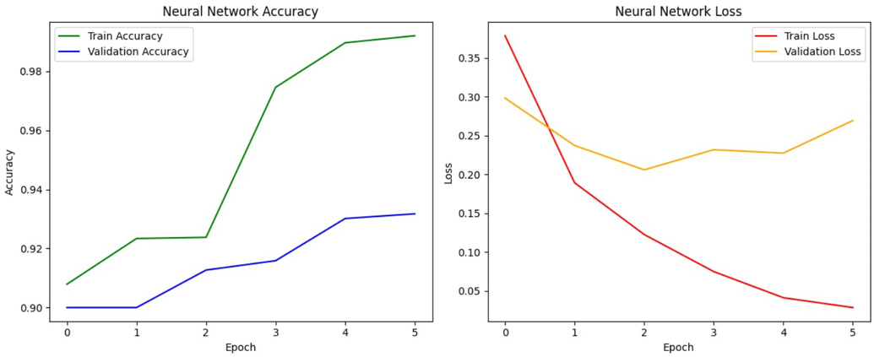
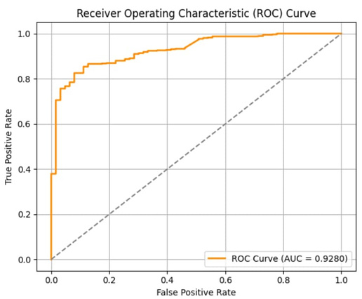
Results of Model Building
Positive word cloud
Negative word cloud
Neural Network Time Series Big O and omega
Roc Accuracy Score

Slide 12
4.Model Deployment
Step 1 : Prepare our machine learning model
Train our model using a suitable dataset.
Step 2 : Set up our streamlit App
Create a new python ﬁle ,e.g ' app.py' ,and import necessary libraries.
Step 3 : Build the user Interface
Add a title and description to our app
Create sliders for user input
Step 4 : Add prediction functionality
Create a button to trigger predictions
Step 5 :Run our app locally
Use the following command in our terminal to run the app

Slide 13
4.Model Deployment
Step 6 : Deploy our app
Create a requirements.txt ﬁle listing alla dependencies
Push our code to a GitHub repository
Sign up for a stream lit account and link it to your GitHub
Click on new app in the streamlit dashboard, select your repository and deploy our app
Step 7 : Share our app
Once deployed,can share the link to your Streamlit app with others , allowing them to use our model for predictionns.

Slide 14
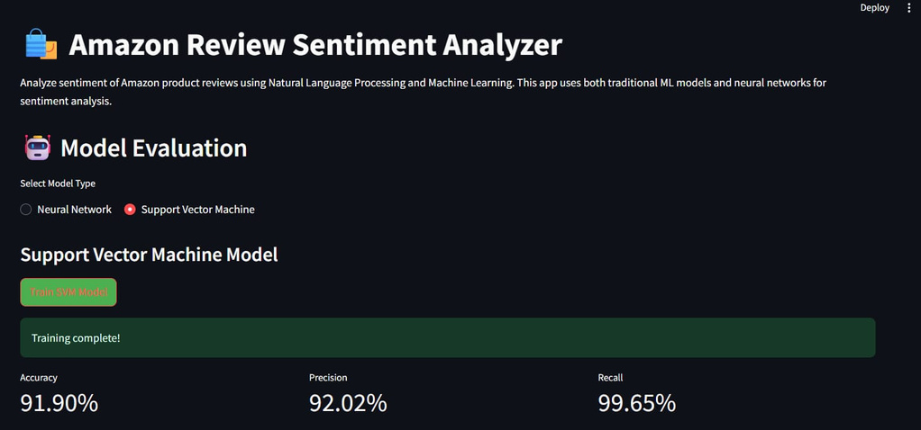
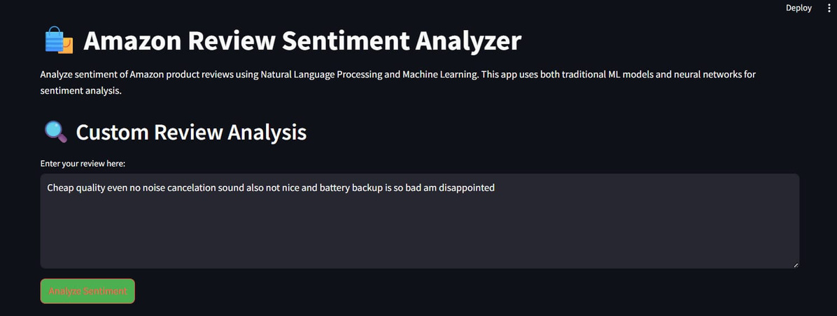
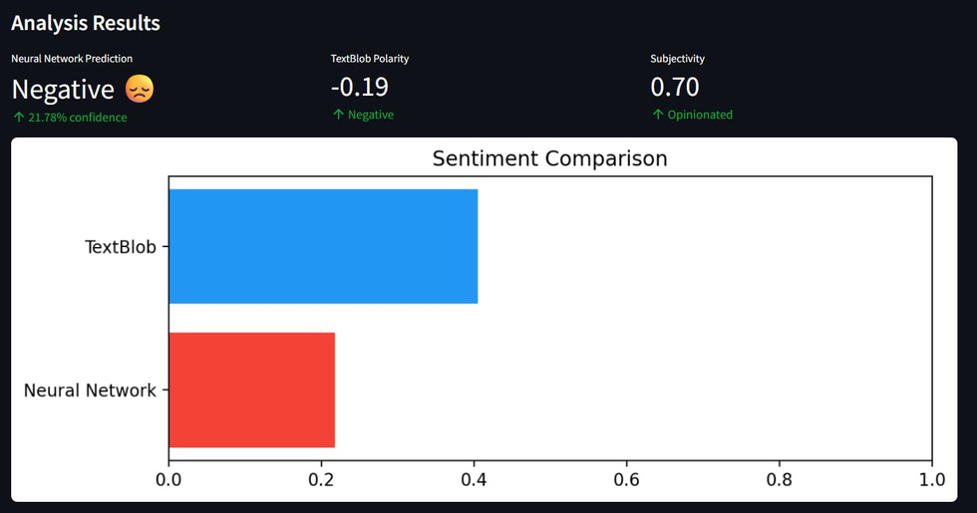
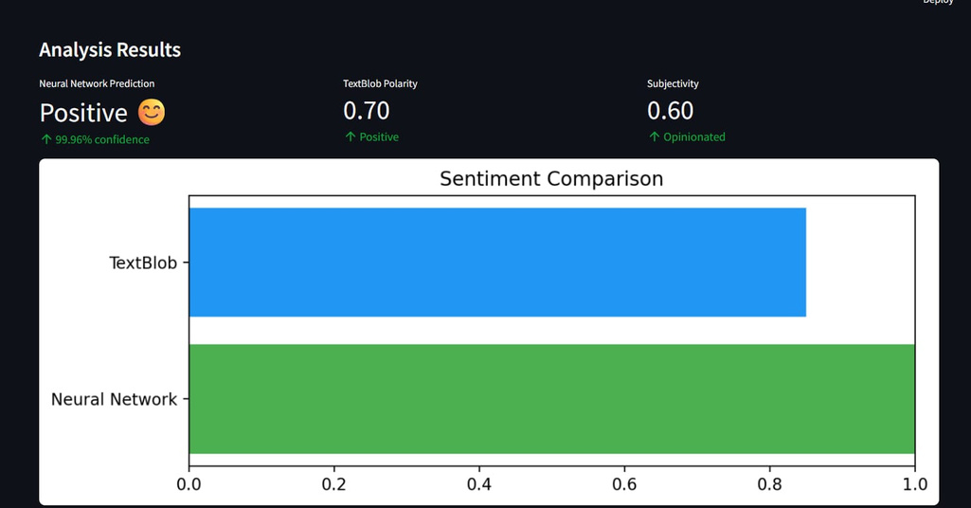
Results of Model Deployment

Slide 15
Advantage
Customer Insights
Product Improvement
Market Trends and Demand Forecasting
Disadvantage
Sarcasm and Irony Detection
Noise and Spam
Mixed Sentiments

Slide 16
Further Usage of Sentiment Analysis (Positive → Negative)
Customer Insights :
Tracking or analyzing how customer sentiment changes over time or across review components — from positive to negative or vice versa — for deeper business insights.
✅ Business Benefits
Early detection of customer dissatisfaction
Product improvement suggestions
Better review authenticity monitoring
Improved customer experience strategies

Slide 17


Conclusion
Performed sentiment analysis on Alexareviews using NLP techniques.
TextBlob provided quick sentimentestimation.
Naive Bayes model offered a strongbaseline for text classiﬁcation.
Future work: Explore deep learning model sand more complex features.

Slide 18
THANK YOU

